Slide 1
PHP : Hypertext Preprocessor
a server-side scripting language
a powerful tool for making dynamic and interactive web pages
widely used
open source scripting language
code executed on the server
result returned to the browser as plain HTML

Slide 2
What PHP Can Do?
can generate dynamic page content
can create, open, read, write, delete and close files on the server
can collect form data
can send and receive cookies
can add, delete, modify data in your database
can encrypt data

Slide 3
Why PHP?
runs on various platforms
compatible with almost all servers used today (Apache, IIS, etc.)
supports a wide range of databases
free

Slide 4
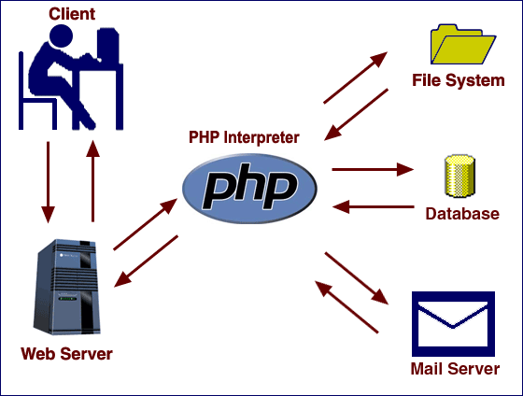
How PHP works?

Slide 5
PHP Syntax
starts with <?php and ends with ?>
default file extension is “.php”
a PHP file contains HTML tags and some PHP code
<?php
// PHP code goes here
?>

Slide 6
PHP Syntax (cont’d)
<!DOCTYPE html>
<html>
<body>
<h1>My first PHP page</h1>
<?php
echo "Hello World!";
?>
</body>
</html>

Slide 7
PHP Syntax (cont’d)
all keywords (e.g. if, else, while, echo, etc.) are NOT case-sensitive
<!DOCTYPE html>
<html>
<body>
<?php
ECHO "Hello World!<br>";
echo "Hello World!<br>";
EcHo "Hello World!<br>";
?>
</body>
</html>

Slide 8
PHP Syntax (cont’d)
all variable names are case-sensitive
<!DOCTYPE html>
<html>
<body>
<?php
$color = "red";
echo "My car is " . $color . "<br>";
echo "My house is " . $COLOR . "<br>";
echo "My boat is " . $coLOR . "<br>";
?>
</body>
</html>

Slide 9
PHP Variables
a variable starts with the $ sign and followed by the name
a variable name must start with a letter or the underscore character
a variable cannot start with a number
PHP is a loosely typed language
<?php
$txt = "Hello world!";
$x = 5;
$y = 10.5;
?>

Slide 10
PHP Variables (cont’d)
variables can be declared anywhere in the script
has three different variable scopes
<?php
$x = 5; // global scope
function myTest() {
echo "<p>Variable x inside function is: $x</p>";
}
myTest();
echo "<p>Variable x outside function is: $x</p>";
?>
<?php
function myTest() {
$x = 5; // local scope
echo "<p>Variable x inside function is: $x</p>";
}
myTest();
echo "<p>Variable x outside function is: $x</p>";
?>

Slide 11
PHP Variables (cont’d)
global keyword is used to access global variable
<?php
$x = 5;
$y = 10;
function myTest() {
global $x, $y;
$y = $x + $y;
}
myTest();
echo $y; // outputs 15
?>
<?php
$x = 5;
$y = 10;
function myTest() {
$GLOBALS['y'] = $GLOBALS['x'] + $GLOBALS['y'];
}
myTest();
echo $y; // outputs 15
?>

Slide 12
PHP Variables (cont’d)
static keyword NOT to delete local variable after execution
<?php
function myTest() {
static $x = 0;
echo $x;
$x++;
}
myTest();
myTest();
myTest();
?>

Slide 13
PHP Data Types
string
integer
float (also known as double)
boolean
array
object
NULL
resource
<?php
$x = 5985;
var_dump($x);
?>
<?php
$x = 10.365;
var_dump($x);
?>

Slide 14
PHP Operators
arithmetic operators (+, -, *, /, %, **)
assignment operators (=, +=, -=, *=, /=, %=)
comparison operators (=, ===, !=, <>, !==, >, <, >=, <=)
increment/Decrement operators (++$x, $x++, --$x, $x--)
logical operators (and, or, xor, &&, ||, !)
string operators (., .=)
array operators (+, ==, ===, !=, <>, !==)

Slide 15
PHP Conditional Statements
if statement - executes some code if one condition is true
if...else statement - executes some code if a condition is true and another code if that condition is false
if...elseif....else statement - executes different codes for more than two conditions
switch statement - selects one of many blocks of code to be executed

Slide 16
PHP Loops
while - loops through a block of code as long as the specified condition is true
do...while - loops through a block of code once, and then repeats the loop as long as the specified condition is true
for - loops through a block of code a specified number of times
foreach - loops through a block of code for each element in an array

Slide 17
PHP Arrays
an array stores multiple values in one single variable
there are three types of arrays
Indexed arrays - Arrays with a numeric index
Associative arrays - Arrays with named keys
Multidimensional arrays - Arrays containing one or more arrays
<?php
$cars = array("Volvo", "BMW", "Toyota");
echo "I like " . $cars[0] . ", " . $cars[1] . " and " . $cars[2] . ".";
?>

Slide 18
PHP Arrays (cont’d)
to loop through and print all the values of an associative array, you could use a foreach loop
<?php
$age = array("Peter"=>"35", "Ben"=>"37", "Joe"=>"43");
foreach($age as $x => $x_value) {
echo "Key=" . $x . ", Value=" . $x_value;
echo "<br>";
}
?>

Slide 19
PHP Superglobals
$GLOBALS
$_SERVER
$_REQUEST
$_POST
$_GET
$_COOKIE
$_SESSION

Slide 20
PHP Superglobals (cont’d)
<html>
<body>
<form method="post" action="<?php echo $_SERVER['PHP_SELF'];?>">
Name: <input type="text" name="fname">
<input type="submit">
</form>
<?php
if ($_SERVER["REQUEST_METHOD"] == "POST") {
// collect value of input field
$name = $_REQUEST['fname'];
if (empty($name)) {
echo "Name is empty";
} else {
echo $name;
}
}
?>
</body>
</html>

Slide 21
PHP Superglobals (cont’d)
<html>
<body>
<a href="test_get.php?subject=PHP&web=W3schools.com">Test $GET</a>
</body>
</html>
<html>
<body>
<?php
echo "Study " . $_GET['subject'] . " at " . $_GET['web'];
?>
</body>
</html>

Slide 22
PHP Forms
<html>
<body>
<form action="welcome.php" method="post">
Name: <input type="text" name="name"><br>
E-mail: <input type="text" name="email"><br>
<input type="submit">
</form>
</body>
</html>
<html>
<body>
Welcome <?php echo $_POST["name"]; ?><br>
Your email address is: <?php echo $_POST["email"]; ?>
</body>
</html>

Slide 23
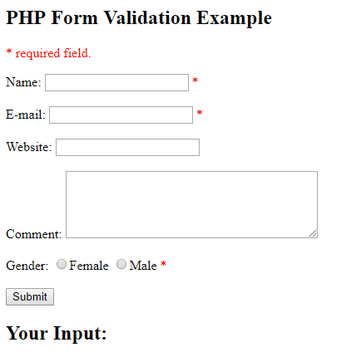
PHP Form Validation

Slide 24
PHP Form Validation (cont’d)
<?php
// define variables and set to empty values
$nameErr = $emailErr = $genderErr = $websiteErr = "";
$name = $email = $gender = $comment = $website = "";
if ($_SERVER["REQUEST_METHOD"] == "POST") {
if (empty($_POST["name"])) {
$nameErr = "Name is required";
} else {
$name = test_input($_POST["name"]);
}
?>

Slide 25
What is XML?
is a language to structure data for sharing across websites
easy to create
looks a lot like HTML, except that you make up your own tags
<students>
<student>
<firstName>John</firstName> <lastName>Doe</lastName>
</student>
<student>
<firstName>Anna</firstName> <lastName>Smith</lastName>
</student>
<student>
<firstName>Peter</firstName> <lastName>Jones</lastName>
</student>
</students>

Slide 26
XML Parser
to read and update, create and manipulate an XML document
<?php
$myXMLData =
"<?xml version='1.0' encoding='UTF-8'?>
<note>
<to>Tove</to>
<from>Jani</from>
<heading>Reminder</heading>
<body>Don't forget me this weekend!</body>
</note>";
$xml=simplexml_load_string($myXMLData) or die("Error: Cannot create object");
print_r($xml);
?>
// OUTPUT: SimpleXMLElement Object ( [to] => Tove [from] => Jani [heading] => Reminder [body] => Don't forget me this weekend! )

Slide 27
XML Parser (cont’d)
<?php
libxml_use_internal_errors(true);
$myXMLData =
"<?xml version='1.0' encoding='UTF-8'?>
<document>
<user>John Doe</wronguser>
<email>john@example.com</wrongemail>
</document>";
$xml = simplexml_load_string($myXMLData);
if ($xml === false) {
echo "Failed loading XML: ";
foreach(libxml_get_errors() as $error) {
echo "<br>", $error->message;
}
} else {
print_r($xml);
}
?>
// Failed loading XML:
// Opening and ending tag mismatch: user line 3 and wronguser
// Opening and ending tag mismatch: email line 4 and wrongemail

Slide 28
What is JSON?
JavaScript Object Notation
is a syntax for storing and exchanging data
is text, written with JavaScript object notation
{“students":[
{ "firstName":"John", "lastName":"Doe" },
{ "firstName":"Anna", "lastName":"Smith" },
{ "firstName":"Peter", "lastName":"Jones" }
]}

Slide 29
JSON Parser
PHP has some built-in functions to handle JSON
objects and arrays in PHP can be converted into JSON by using the PHP function json_encode()
<?php
$myObj->name = "John";
$myObj->age = 30;
$myObj->city = "New York";
$myJSON = json_encode($myObj);
echo $myJSON;
$myArr = array("John", "Mary", "Peter", "Sally");
$myJSON = json_encode($myArr);
echo $myJSON;
?>

Slide 30
JSON Parser (cont’d)
json_decode decodes a JSON string into a PHP variable
<?php
// JSON string
$someJSON = '[{"name":"Jonathan Suh","gender":"male"},{"name":"William Philbin","gender":"male"},{"name":"Allison McKinnery","gender":"female"}]';
// Convert JSON string to Array
$someArray = json_decode($someJSON, true);
foreach ($someArray as $key => $value) {
echo $value["name"] . ", " . $value["gender"] . "<br>";
}
// Convert JSON string to Object
$someObject = json_decode($someJSON);
foreach($someObject as $key => $value) {
echo $value->name . ", " . $value->gender . "<br>";
}
?>

Slide 31
MySQL
a database system used on the web
a database system that runs on a server
ideal for both small and large applications
is very fast, reliable, and easy to use
uses standard SQL
is free to download and use
is developed, distributed, and supported by Oracle Corporation

Slide 32
MySQL (cont’d)
data in a MySQL database are stored in tables
table is a collection of related data
table consists of columns and rows
databases are useful for storing information categorically
A company may have a database with the following tables:
Employees
Products
Customers
Orders

Slide 33
PRIMARY KEY Constraint
the PRIMARY KEY constraint uniquely identifies each record in a database table
must contain UNIQUE values, and cannot contain NULL values
a table can have only one primary key, which may consist of single or multiple fields
CREATE TABLE students (
ID int NOT NULL,
LastName varchar(255) NOT NULL,
FirstName varchar(255),
Age int,
PRIMARY KEY (ID)
);

Slide 34
FOREIGN KEY Constraint
a FOREIGN KEY is a key used to link two tables together
is a field in one table that refers to the PRIMARY KEY in another table
CREATE TABLE exams (
ExamID int NOT NULL,
ExamName int NOT NULL,
Marks int,
PRIMARY KEY (ExamID),
FOREIGN KEY (StudentID) REFERENCES Persons(StudentID)
);

Slide 35
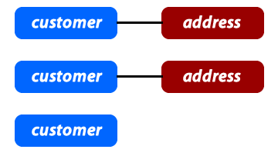
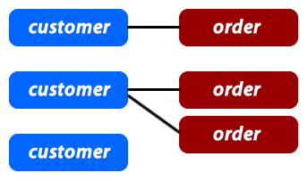
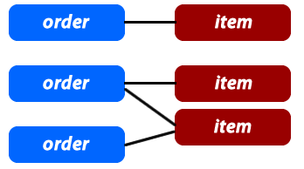
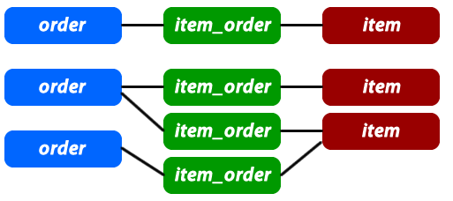
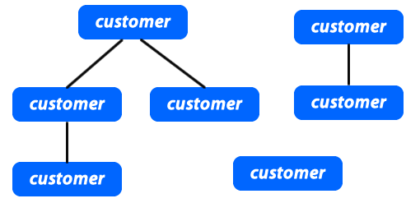
Database Relationships
One to One
One to Many
Many to Many
Self Referencing

Slide 36
Create a MySQL Database
<?php
$servername = "localhost";
$username = "username";
$password = "password";
// Create connection
$conn = new mysqli($servername, $username, $password);
// Check connection
if ($conn->connect_error) {
die("Connection failed: " . $conn->connect_error);
}
// Create database
$sql = "CREATE DATABASE myDB";
if ($conn->query($sql) === TRUE) {
echo "Database created successfully";
} else {
echo "Error creating database: " . $conn->error;
}
$conn->close();
?>

Slide 37
Create a MySQL Table
<?php
// Create connection
$conn = new mysqli($servername, $username, $password, $dbname);
// sql to create table
$sql = "CREATE TABLE students (
id INT(6) UNSIGNED AUTO_INCREMENT PRIMARY KEY,
firstname VARCHAR(30) NOT NULL,
lastname VARCHAR(30) NOT NULL,
email VARCHAR(50),
reg_date TIMESTAMP
)";
if ($conn->query($sql) === TRUE) {
echo "Table students created successfully";
} else {
echo "Error creating table: " . $conn->error;
}
$conn->close();
?>

Slide 38
Insert Data in a Table
<?php
// Create connection
$conn = new mysqli($servername, $username, $password, $dbname);
// Check connection
if ($conn->connect_error) {
die("Connection failed: " . $conn->connect_error);
}
$sql = "INSERT INTO students (firstname, lastname, email)
VALUES ('John', 'Doe', 'john@example.com')";
if ($conn->query($sql) === TRUE) {
echo "New record created successfully";
} else {
echo "Error: " . $sql . "<br>" . $conn->error;
}
$conn->close();
?>

Slide 39
Insert Data in a Table (cont’d)
$sql = "INSERT INTO students (firstname, lastname, email)
VALUES ('John', 'Doe', 'john@example.com')";
if ($conn->query($sql) === TRUE) {
$last_id = $conn->insert_id;
echo "New record created successfully. Last inserted ID is: " . $last_id;
} else {
echo "Error: " . $sql . "<br>" . $conn->error;
}

Slide 40
Select Data From a Table
<?php
// Create connection
$conn = new mysqli($servername, $username, $password, $dbname);
// Check connection
if ($conn->connect_error) {
die("Connection failed: " . $conn->connect_error);
}
$sql = "SELECT id, firstname, lastname FROM students";
$result = $conn->query($sql);
if ($result->num_rows > 0) {
// output data of each row
while($row = $result->fetch_assoc()) {
echo "id: " . $row["id"]. " - Name: " . $row["firstname"]. " " . $row["lastname"]. "<br>";
}
} else {
echo "0 results";
}
$conn->close();
?>

Slide 41
Delete Data From a Table
<?php
// Create connection
$conn = new mysqli($servername, $username, $password, $dbname);
// Check connection
if ($conn->connect_error) {
die("Connection failed: " . $conn->connect_error);
}
// sql to delete a record
$sql = "DELETE FROM students WHERE id=3";
if ($conn->query($sql) === TRUE) {
echo "Record deleted successfully";
} else {
echo "Error deleting record: " . $conn->error;
}
$conn->close();
?>

Slide 42
Update Data In a Table
<?php
// Create connection
$conn = new mysqli($servername, $username, $password, $dbname);
// Check connection
if ($conn->connect_error) {
die("Connection failed: " . $conn->connect_error);
}
$sql = "UPDATE schools SET lastname='Doe' WHERE id=2";
if ($conn->query($sql) === TRUE) {
echo "Record updated successfully";
} else {
echo "Error updating record: " . $conn->error;
}
$conn->close();
?>

Slide 43
Different Types of SQL JOINs
(INNER) JOIN: Returns records that have matching values in both tables
LEFT (OUTER) JOIN: Return all records from the left table, and the matched records from the right table
RIGHT (OUTER) JOIN: Return all records from the right table, and the matched records from the left table
FULL (OUTER) JOIN: Return all records when there is a match in either left or right table

Slide 44
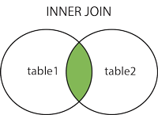
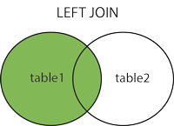
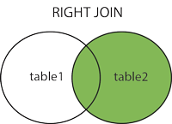
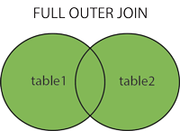
Different Types of SQL JOINs (cont’d)

Slide 45
Different Types of SQL JOINs (cont’d)
// INNER JOIN
SELECT Exams.ExamID, Students.StudentName
FROM Exams
INNER JOIN Students ON Exams.StudentID = Students.StudentID;
// LEFT JOIN
SELECT Students.StudentName, Exam.ExamID
FROM Students
LEFT JOIN Exams ON Students.StudentID = Exams.ExamID
ORDER BY Students.StudentName;
// RIGHT JOIN
SELECT Exam.ExamID, Employees.LastName, Employees.FirstName
FROM Exams
RIGHT JOIN Students ON Exams.StudentID = Students.StudentID
ORDER BY Orders.OrderID;
// FULL OUTER JOIN
SELECT Students.StudentsName, Exams.ExamID
FROM Students
FULL OUTER JOIN Exams ON Students.StudentID=Exams.StudentID
ORDER BY Students.StudentName;

Slide 46
Exercise
Extract And Store Historical BikeSharing and CarParking Data
BikeSharing Data https://os.smartcommunitylab.it/core.mobility/bikesharing/trento
CarParking Data
http://opendata.5t.torino.it/get_pk

Slide 47
Exercise (cont’d)
BikeSharing Data
[{"name":"Aeroporto","address":"Via Lidorno / Aeroporto Caproni","id":"Aeroporto - Trento","bikes":2,"slots":6,"totalSlots":8,"position":[46.01983619754026,11.127080654939277]},{"name":"Azienda Sanitaria","address":"Via De Gasperi - Lato Trento Frutta","id":"Azienda Sanitaria - Trento","bikes":15,"slots":3,"totalSlots":18,"position":[46.044433415996814,11.12804971230321]},{"name":"Bezzi","address":"Via Bezzi / Via Vittorio Veneto","id":"Bezzi - Trento","bikes":8,"slots":1,"totalSlots":9,"position":[46.058020904033015,11.119315767528406]},{"name":"Biblioteca","address":"Via Alfieri / Via Torre Vanga","id":"Biblioteca - Trento","bikes":7,"slots":16,"totalSlots":24,"position":[46.07043395910254,11.121399842327946]},{"name":"Bren Center","address":"Via Guardini fr. civ. 75","id":"Bren Center - Trento","bikes":6,"slots":12,"totalSlots":18,"position":[46.094653868146885,11.117693389024225]},{"name":"Centro Santa Chiara","address":"Via S. Croce 78","id":"Centro Santa Chiara - Trento","bikes":7,"slots":11,"totalSlots":18,"position":[46.06345393738132,11.12375366752849]},{"name":"Cimitero","address":"via Madruzzo / via Rosmini","id":"Cimitero - Trento","bikes":3,"slots":7,"totalSlots":10,"position":[46.063653753791996,11.119203004368615]}]

Slide 48
Exercise (cont’d)
CarParking Data
<td:traffic_data xmlns:td="http://www.5t.torino.it/simone/ns/traffic_data" xmlns:xsi="http://www.w3.org/2001/XMLSchema-instance" xsi:schemaLocation="http://www.5t.torino.it/simone/ns/traffic_data http://www.5t.torino.it/simone/ns/traffic_data.xsd" datatype="misura" generation_time="2018-03-01T12:28:03+01:00" start_time="2018-03-01T12:23:03+01:00" end_time="2018-03-01T12:28:03+01:00" source="5T.PARK">
<td:location_reference>
<td:tmc_info tabcd="1" cid="25"/>
</td:location_reference>
<td:PK_data Name="BODONI" ID="2" status="1" Total="468" Free="184" tendence="-1" lat="45.06355" lng="7.68357"/>
<<td:PK_data Name="RICHELMY" ID="49" status="1" Total="133" Free="77" tendence="1" lat="45.08307" lng="7.65769"/>
<td:PK_data Name="CERNAIA" ID="55" status="1" Total="94" Free="76" tendence="1" lat="45.06936" lng="7.67348"/>
<td:PK_data Name="BACIGALUPO" ID="46" status="1" Total="332" Free="84" tendence="1" lat="45.03660" lng="7.67249"/>
<td:PK_data Name="VENCHI UNICA" ID="48" status="1" Total="449" Free="244" tendence="-1" lat="45.07410" lng="7.61576"/>
</td:traffic_data>

